Slide 1
Essential Workers Essential Protections

Slide 2
Wage and Hour Division
Who we are

Slide 3
Protecting Your Rights to Pay and Leave

Slide 4
Enforcing Workplace Protections
10 million establishments nationwide and 148 million workers covered.
More than 200 WHD offices throughout the country.
More than 200 languages spoken.

Slide 5
Enforcement Regardless of Immigration Status
Labor laws cover all workers, regardless of immigration status
Protections apply regardless of immigration status
WHD does not ask workers about their immigration status

Slide 6
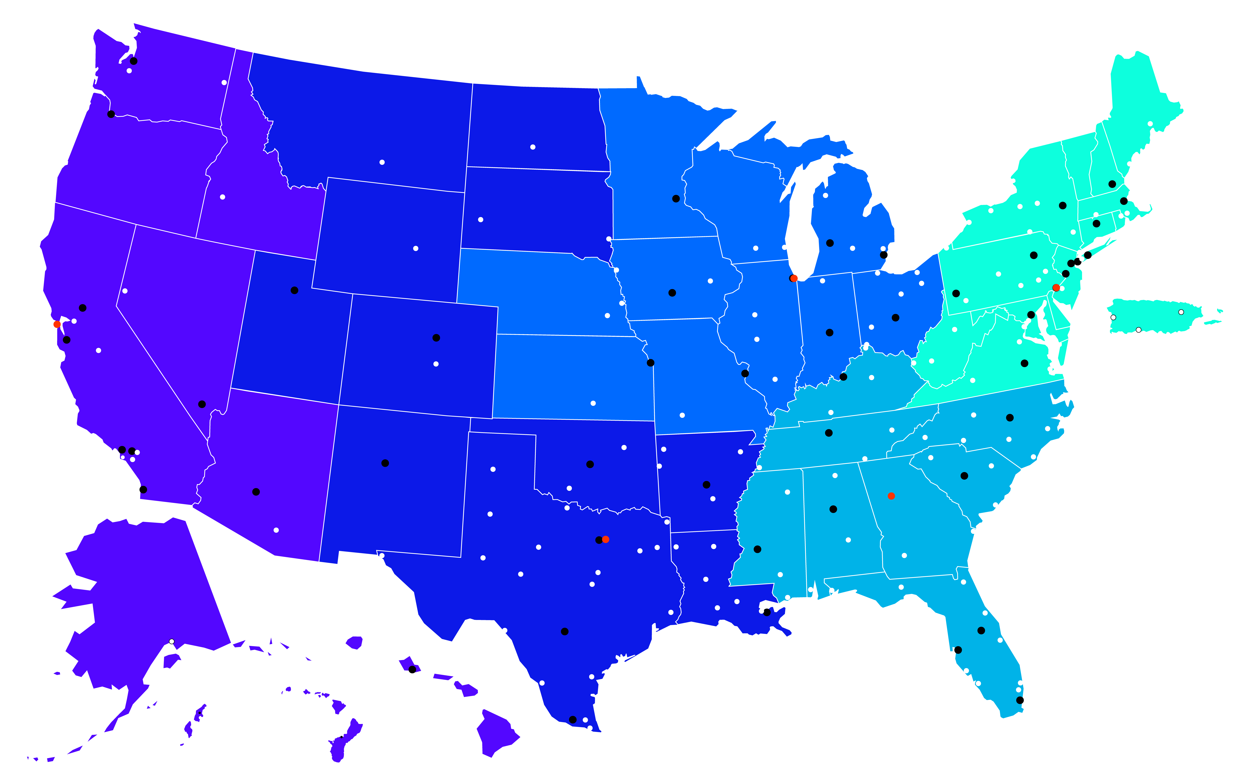
Helping Workers Throughout the Country
866-4US-WAGE

Slide 7
Regional Outreach Events
Planning more than 100 local outreach events
Keep an eye out for more information about these events, including registration links
WHD is committed to working with stakeholders to ensure that all workers receive the rights they are entitled to under the law.
Collaborations and Consultations
Community-Based
Business Associations
Federal and State Agencies
Worker Rights Organizations
Foreign Consulates

Slide 8
Ensuring Fair Pay

Slide 9
Wage and Hour Division
What we do

Slide 10
Achieving Compliance
Investigations
Outreach to workers
Education for employers
Partnerships

Slide 11
Agency-Initiated Enforcement
National and regional strategic enforcement initiatives focus on industries that employ essential workers

Slide 12
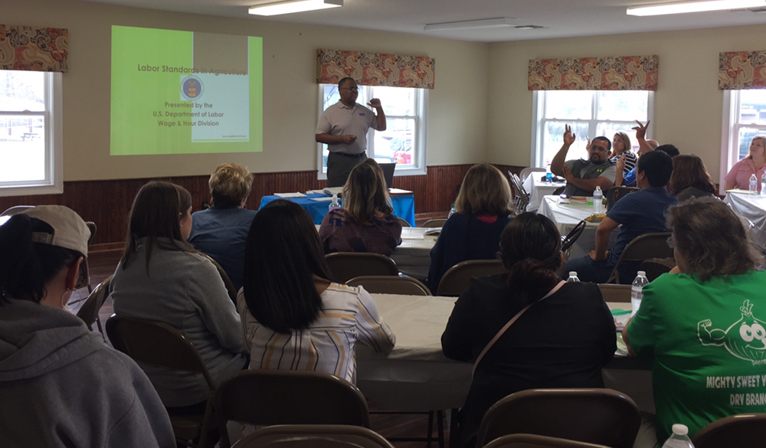
Education promotes compliance
Education and outreach for workers to understand and exercise their rights
Education and outreach for employers to increase compliance

Slide 13
Increasing Our Impact
Collaborations and consultations
Communities of Color
Community-based organizations
Worker Centers
Unions
Business associations
Federal and state agencies
Worker rights organizations
Foreign consulates
WHD is committed to working with stakeholders to ensure that all workers receive the rights they are entitled to under the law.
Collaborations and Consultations
Community-Based
Business Associations
Federal and State Agencies
Worker Rights Organizations
Foreign Consulates

Slide 14
Wage and Hour Division
We serve workers
and employers

Slide 15
Essential Workers
Agriculture
Health Care
Grocery
Delivery Services
First Responders
Public Transportation
Restaurant
Construction
Guards
Hotel Workers
Landscaping
Janitorial Services

Slide 16
Risks for Essential Workers
Low wages
Work “off the clock”
At-risk employment relationships (including misclassification)
Increased exposure to a variety of workplace risks and hazards
Denial of qualified leave

Slide 17
Essential Protections
Payment of minimum wages and overtime
Youth employment standards
Job protections for time taken for the birth of a child or caring for sick family members
Housing and transportation standards for farm workers
Payment of prevailing wage rates for federally funded construction and service contract work
Standards for hiring and paying workers temporarily in the U.S under H-2A, H-1B and H-2B visas

Slide 18
Essential Protections
Under the Fair Labor Standards Act

Slide 19
Fair Labor Standards Act (FLSA)
Essential Protections:
Minimum wage: $7.25 per hour
Overtime at “time and one-half” for hours worked over forty in a workweek
Recordkeeping requirements
Prohibited youth employment
Anti-retaliation provisions

Slide 20
Hours Worked
Hours worked per day and per workweek for the same employer
Whether or not the employer counts the time as work time

Slide 21
Common Questions
Question:
My employer requires all employees to take their temperature related to COVID-19 before entering the job site. Do I need to be paid for the time spent taking my temperature?

Slide 22
Regular Rate of Pay
Gross Weekly Straight Time Pay
HOURLY RATE = ----------------------------------------------- Total Hours Worked Weekly

Slide 23
Regular Rate Example
50 hours @ $10.00 per hour
+ $100 bonus
$600 total compensation
$600/50 hours = Regular Rate of $12.00/hour
(Overtime needs to be based on $12.00/hour, not $10.00 hour)

Slide 24
Common Questions
Question:
I am an employee of a private employer that began paying me incentive payments, such as hazard pay, for working during the COVID-19 emergency. Do those incentive payments have to be included in the regular rate that is used to compute my overtime pay?

Slide 25
Child Labor
In non-agricultural jobs…
Minimum age of employment is 14
Hours and occupations are restricted for 14- and 15-year-olds
Hazardous occupations are prohibited for every covered worker under 18 years of age
Some exceptions for minors working for their parents

Slide 26
Child Labor
Hours Restrictions in non-agricultural jobs…
Apply to 14- and 15-year-olds only
Not during school hours
No more than 3 hours on a school day or 8 hours on a non-school day
No more than 18 hours during school weeks or 40 hours during non-school weeks
Not before 7 a.m. and not after 7 p.m. except from June 1 to Labor Day when the time is extended until 9 p.m.

Slide 27
Common Questions
Question:
I am 15 years old. My school has physically closed due to COVID-19, but it would normally be in session. Am I permitted to work if I cannot physically go to classes?

Slide 28
Rest Breaks for Nursing Mothers
Section 7 of the FLSA was amended by the Affordable Care Act to provide nursing employees, for up to 1 year after the child’s birth, with:
Reasonable break time to express breast milk
A place, other than a bathroom, that may be used to express milk

Slide 29
Common Questions
Question:
Are nursing mothers entitled to reasonable break time and space to express milk while teleworking during the COVID-19 pandemic?

Slide 30
Essential Protections
Under the Family Medical Leave Act

Slide 31
Family and Medical Leave Act
Essential Protections:
Twelve workweeks of unpaid leave per leave year for qualifying reasons
Job protection
Protection of benefits and status while on leave
Return to the same or an equivalent position

Slide 32
Common Questions
Question:
Can an employee who is sick with COVID-19, or who is caring for a family member who is sick with COVID-19, take FMLA leave?

Slide 33
Tax Credits for Paid Sick Leave
American Rescue Plan extended tax credits for employers through September 30, 2021
Up to $12,000 per worker
Visit IRS.gov for more information

Slide 34
Families First Coronavirus Response Act
Provided paid leave for COVID-19 related reasons.
Applied to leave taken between April 1, 2020 and December 31, 2020.
If an employer failed to pay a worker as required, worker may still file a complaint for up to two years.

Slide 35
Essential Protections
For Agricultural Workers

Slide 36
Agricultural Workers
Essential protections:
Disclosure of wages, safe transportation and housing, field sanitation requirements, and protection for H-2A non-immigrant workers.
Toilets, potable drinking water, and hand-washing facilities for hand-laborers in the field.
Payment of a required wage and minimum guaranteed hours for H-2A workers.
Protections apply regardless of immigration status.

Slide 37
Common Questions
Question:
I live with other agricultural workers in employer-provided housing and I am worried about the spread of COVID-19. Are there rules about overcrowding?

Slide 38
Wage and Hour Division
How we can help

Slide 39
How to File a Complaint
Complaints can be submitted by phone.
Complaints can come from third parties.
Complaints are confidential.
WHD does not ask workers about their immigration status.
No fee to file a complaint.

Slide 40
Who May File a Complaint?
Employees – Former and Present
Parent/Guardian
School Officials
Other Employers
Advocacy Groups
Other Agencies

Slide 41
Complaint Intake Information
Employee’s name
Contact information
Address and phone number
Employee’s duties/work
Circumstances or actions that caused potential violation of the law
Copies of pay stubs or personal hours worked records if available
Employer’s name
Point of contact
Address and phone number
This information is not required, but helps develop the case

Slide 42
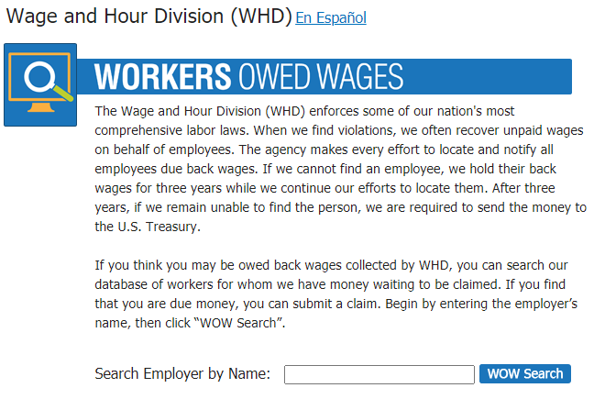
Online Resources
Workers owed back wages may be difficult to locate
WHD searches for these workers
“Workers Owed Wages” provides online access for workers and advocates to search our database
www.dol.gov/wow

Slide 43
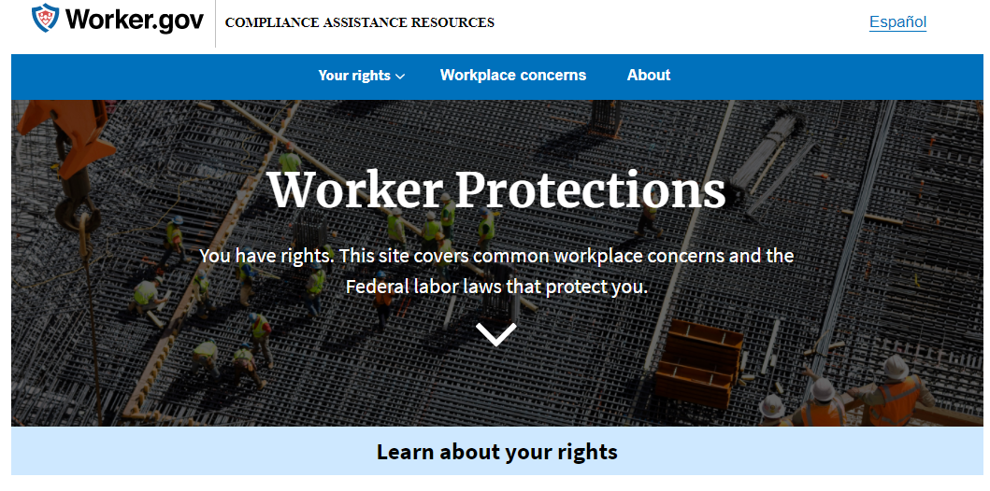
Online Resources
Worker.gov
Employer.gov

Slide 44
Online Resources
Elaws Advisors
Coverage and employment status advisor
Overtime calculator
Overtime security advisor
Hours worked advisor
dol.gov/elaws

Slide 45
Contact Us
Visit www.dol.gov/agencies/whd
Call our toll-free information and helpline at 1-866-4US-WAGE (1-866-487-9243)

Slide 46
Disclaimer
This presentation is intended as general information only and does not carry the force of legal opinion.
The Department of Labor is providing this information as a public service. This information and related materials are presented to give the public access to information on Department of Labor programs. You should be aware that, while we try to keep the information timely and accurate, there will often be a delay between official publications of the materials and the modification of these pages. Therefore, we make no express or implied guarantees. The Federal Register and the Code of Federal Regulations remain the official source for regulatory information published by the Department of Labor. We will make every effort to keep this information current and to correct errors brought to our attention.

